Slide 1


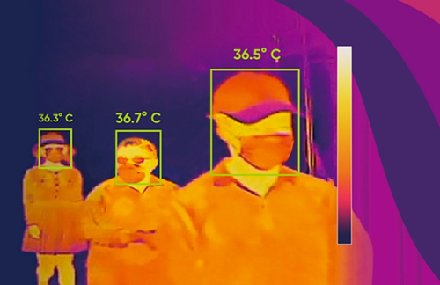
Fever Scanner
ITAS 164

Slide 2

Team members
Miku Croft
Milad
Zhipeng Wu

Slide 3


Project goal
Creating a device that measures your body temperature and determines it’s within the accepted range or not.
Students scan their ID tag on the NFC reader and that triggers the scanner.

Slide 4

Stakeholders
Team members
Instructors
Classmates

Slide 5


Resources available
3D printer
Monitor
Raspberry Pi
Screen
Mini HDMI cable
NFC reader and tags
YouTube videos and online resources

Slide 6
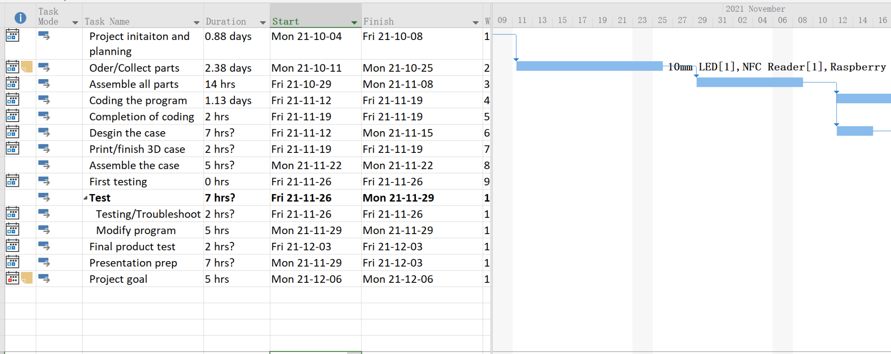
MS Project
Gantt Chart

Slide 7
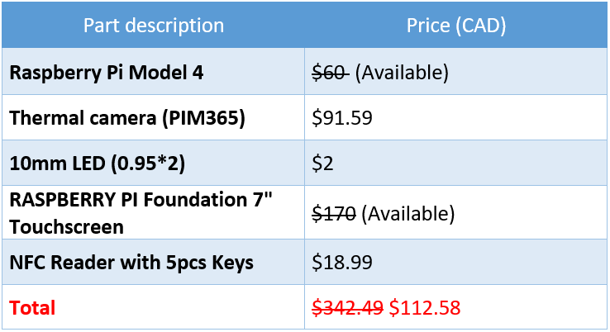
Budge: Approx $112
Raspberry Pi and Raspberry Pi Screen were available from ITAS.
We did not use LED for the project
Most parts were purchased from Amazon and Digikey.ca

Slide 8
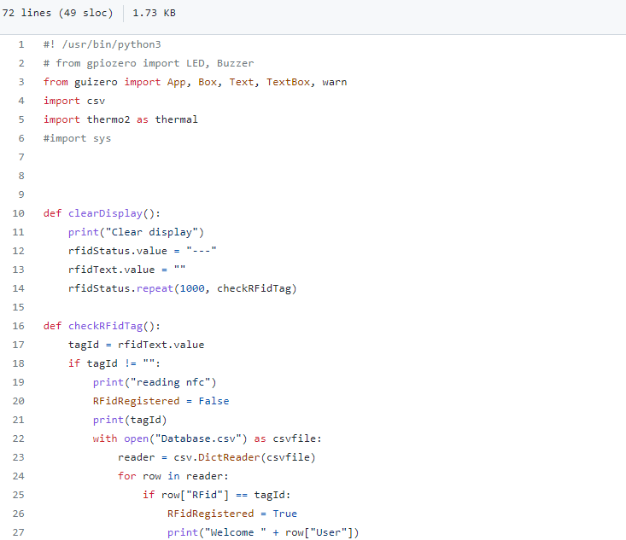
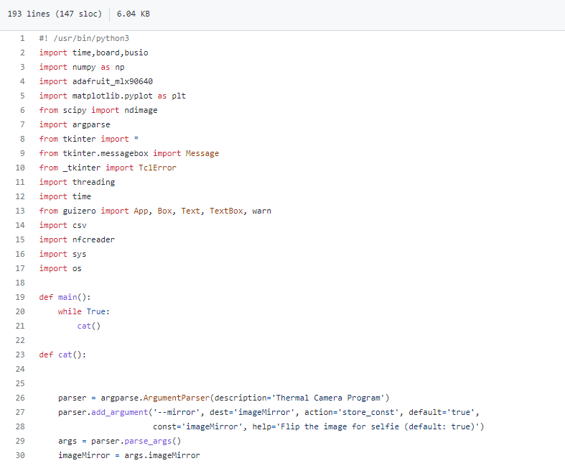
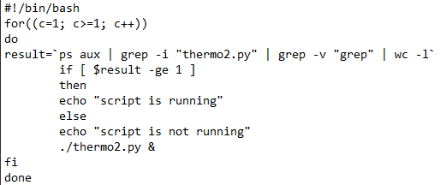
Scripts
3 Main Files:
thermal.py
Thermal camera main program to display thermal image and measure body temperature.
nfcreader.py
NFC Reader program to identify the ID.
run.sh
Re-start the main program when the finish the measure body temperature.

Slide 9
Thermal camera
Basic plan is to follow a tutorial from a YouTube video
(src: https://github.com/pimoroni/mlx90640-library)
Issues
-Positioning the camera sensor into the right pins on Raspberry Pi was confusing
-Connection between the camera and the Raspberry Pi was unstable
🡪We had to bend the end of the pins to stabilize them
-Found an error : ”I2C read error”
🡪Turned out I2C was disabled
(sudo raspi-config 🡪 #3 Interface options 🡪P5 ic2 enable/disable section)

Slide 10
Setting up a LED light and temperature screen
-Watched YouTube tutorial and figured out how to connect the light and Pi.
(Blue for ground, black for positive 🡪 red light)
(Yellow for ground, green for positive 🡪 green light)
-Copy Python coding from the same video
-Program the light to stay on for 5 sec.
(‘light on’ command 🡪 time.sleep(5.5)🡪 ‘light off’ command)
-Give up LED light plan as we found a screen for Raspberry Pi

Slide 11
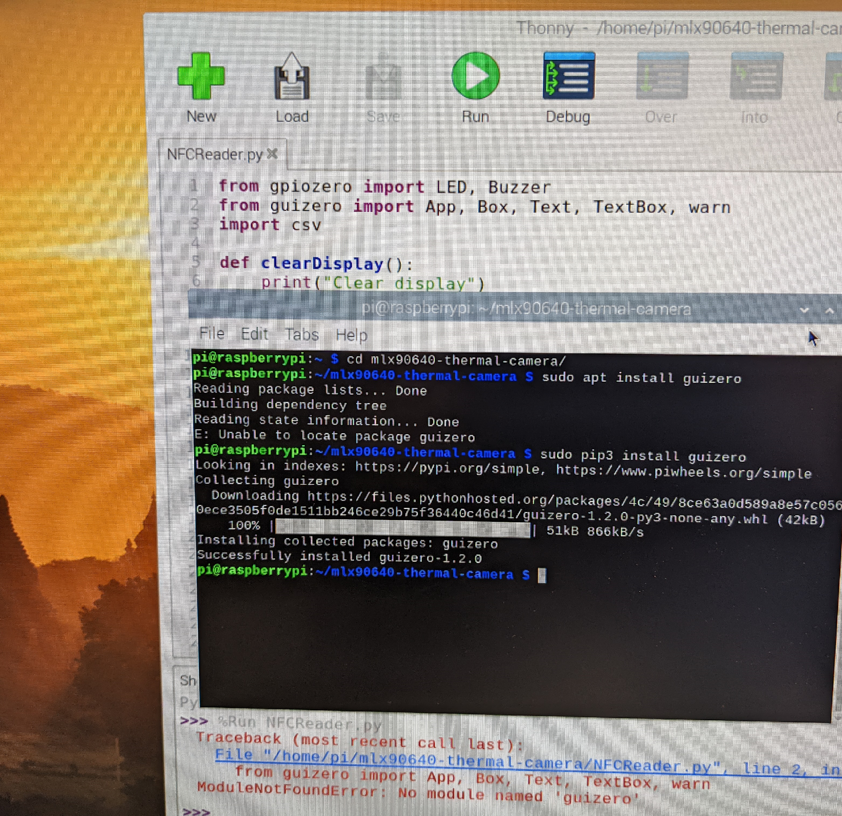
Setting up and programming the NFC reader
-Insert the reader to the USB port 🡪 Tags were scanned & ID numbers were displayed
-Copy a set of code from YouTube
🡪 code doesn’t work! 🡪 Import library on terminal
-Creating database for student ID

Slide 12
Coding the program
Issues
-Getting accurate temperature from the camera sensor
(the sensor needs to warm up)
→ used ‘sleep’ (pause) statement to pause for 3 seconds
→ added a while loop (count=1, while count<6 repeat reading)
This way, the program reads the temperature 3-4 times
(accurate enough temperature achieved)

Slide 13
Coding the program
-When the tag is scanned ONCE, it shows student ID.
🡪 Need to modify the code so it shows student ID EVERYTIME the tag is scanned
→ Added a comment #! /usr/bin/python3 in the NFCReader file so the program knows which library to look at.
-Clearing Student ID display after scanning
→ Needs to be cleared after a few seconds of scanning
→ led8.on() and led.8off() comment were removed from the code
*** Photo on the next slide...

Slide 14
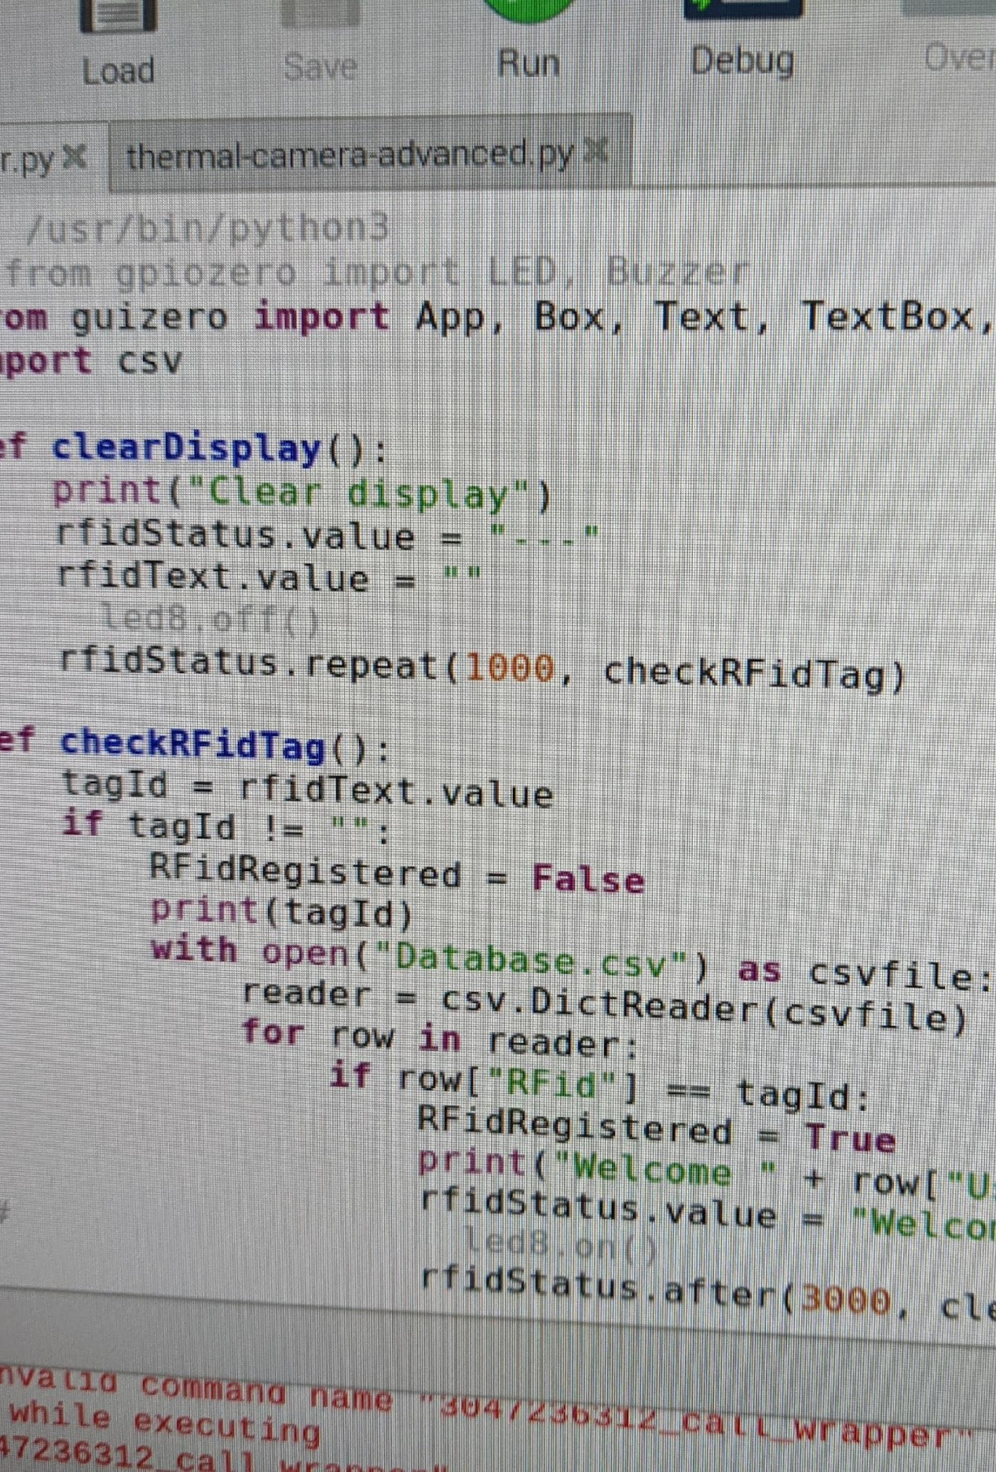

Slide 15
Merging the NFC reader program and thermo program
Our goal was to open the thermo scan program when student ID is scanned
→ This turned out to be the biggest challenge of our project!
We added two libraries (import : Thermo2 and nfcreader) to read the program inside of the other program and trigger them to each other.
Down below we added the main function to read through whole program on thermo2
Def main()
-if __name__==“__main__”:
main()
We managed to make the program to start when the ID tag was scanned.
(ID tag scan 🡪 Thermo window opens 🡪 starts measuring temperature)
We can run the program only once.
🡪We need to reset the program (close windows ) so we can scan the next student’s ID tag.
<!--- Milad could you explain this part? --->

Slide 16
<!--- We can write more about coding --->
<!--- Not sure how to organize this part --->
<!--- Sorry :( --->

Slide 17
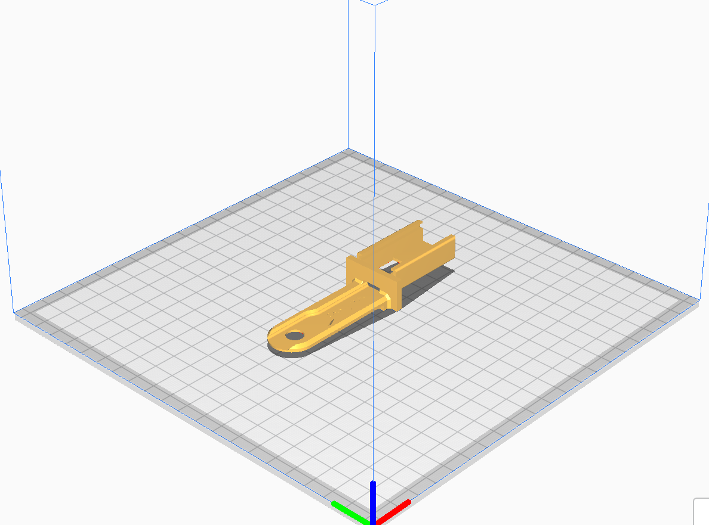
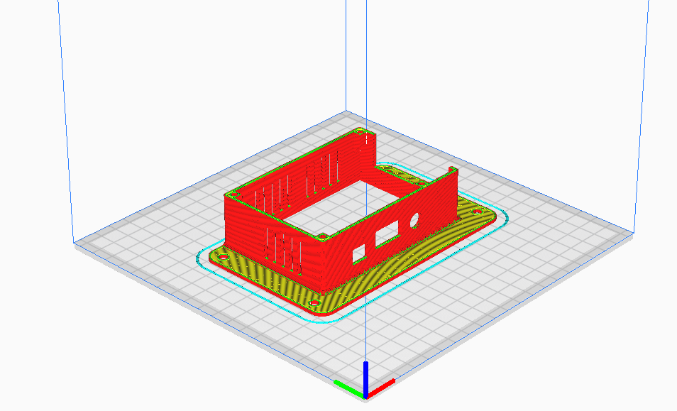
Designing/3D Printing the case
This project uses 3D printing, approx. 18 hours of total printing excluding warm up and failed print.
Found a design model for the case in ‘Thingiverse’
Source: https://www.thingiverse.com/
Modify the designs to fit our project

Slide 18
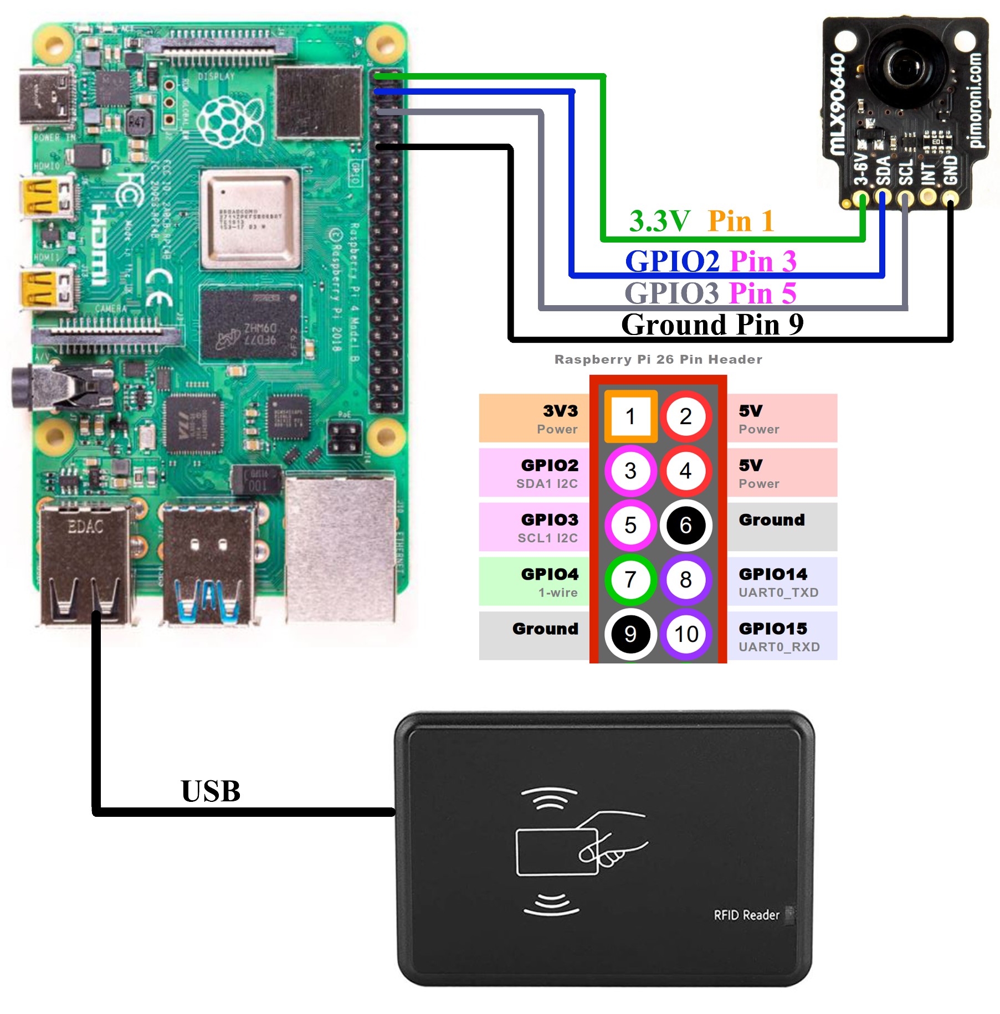
Raspberry Pi Connection
Pin 1 3V3
Power supply
Pin 3 and 5 GPIO2/3
I2C data (input/out)
Pin 5 Ground
NFC Reader
USB connection

Slide 19
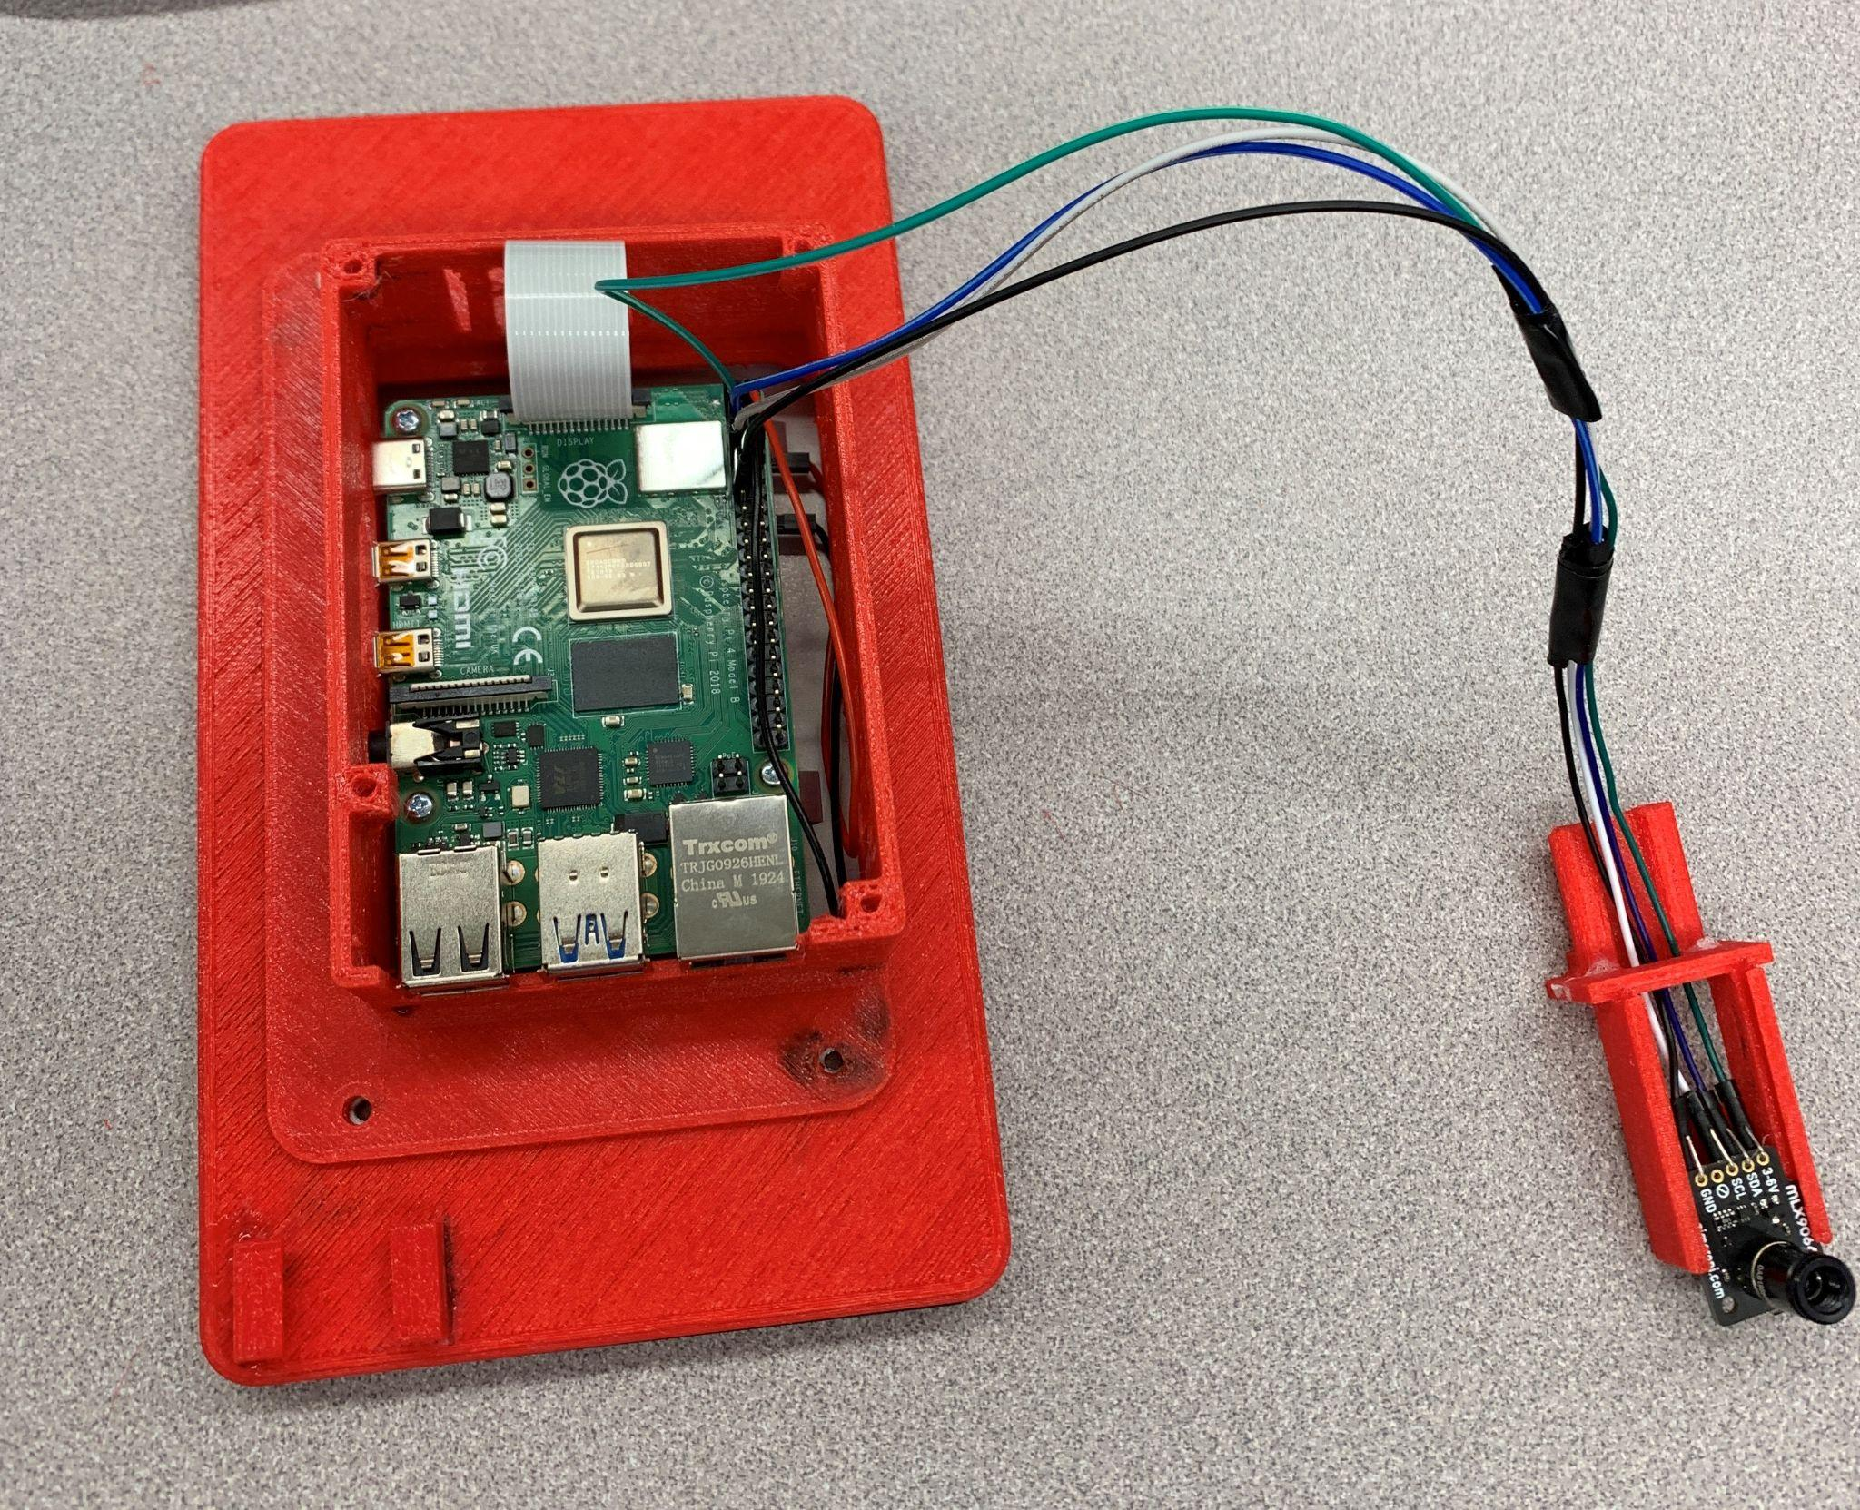
Final Product

Slide 20
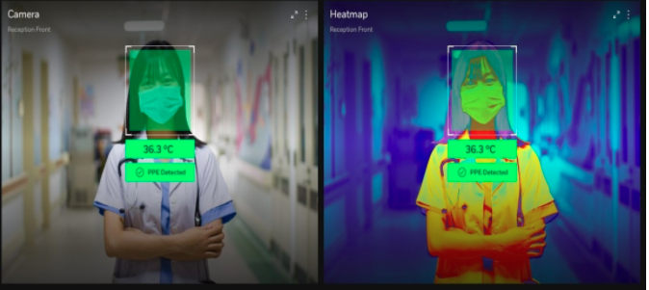
Things we would do differently (1/3 )
Normal camera
Adding a normal camera on the product
Overlay the camera image on top of the thermal image

Slide 21
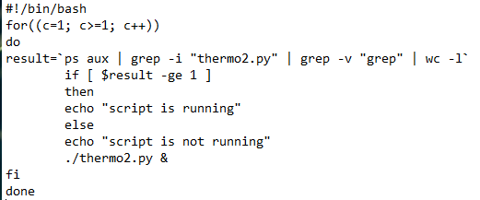
Things we would do differently (2/3 )
Coding modification
run.sh
Infinite loop on the background
Overuse CPU

Slide 22

Things we would do differently (3/3 )
System Log and Email Notification
Able to know who was here
Notify school Security
Track the system error

Slide 23
Thanks!
ITAS
Dave Croft
David Grant
ITAS Classmates

